Slide 1

Automated FIRST and FOLLOW Set Generator
Supervisor CSE-Students
Dr. S Magesh Kumar D V Sai kumar-192372321
Dr. L Karthikeyan M Vamsi-192325041
K Abhi-192325032
Department of CSE Department of CSE
Saveetha School of Engineering Saveetha School of Engineering
Notes:
1
1

Slide 2
Introduction
Context-Free Grammars (CFGs) are used to define the syntax of programming languages in compiler design.
FIRST and FOLLOW sets are essential for syntax analysis and LL(1) parser construction.
Manual computation of FIRST and FOLLOW sets is complex and prone to errors.
This project automates the calculation of FIRST and FOLLOW sets for a given grammar.
The system uses standard set algorithms to ensure correctness and reliability.
The generated parsing sets help in efficient and accurate grammar analysis.

Slide 3
Problem Statement
Manual calculation of FIRST and FOLLOW sets for context-free grammars is time-consuming and error-prone.
Complex and recursive grammars increase the difficulty of accurate parsing set computation.
Incorrect FIRST and FOLLOW sets can lead to faulty LL(1) parse tables and parsing errors.
There is a lack of simple automated tools that validate grammars before computing parsing sets.
An efficient and reliable system is required to automatically generate correct FIRST and FOLLOW sets for grammar analysis.

Slide 4
Literature Review
S.No | Author(s) & Year | Title / Source | Key Findings | Relevance to Project
1 | Aho, A. V., Lam, M. S., Sethi, R., & Ullman, J. D. (2006) | Compilers: Principles, Techniques, and Tools – Pearson | Explained formal algorithms for FIRST and FOLLOW set computation and LL(1) parsing techniques. | Provides the theoretical foundation for FIRST and FOLLOW set algorithms used in this project.
2 | Grune, D. & Jacobs, C. (2008) | Parsing Techniques: A Practical Guide – Springer | Discussed efficient parsing methods and grammar analysis techniques. | Supports the design of reliable parsing set computation methods.
3 | Sudkamp, T. A. (2011) | Languages and Machines: An Introduction to the Theory of Computer Science – Addison-Wesley | Presented step-by-step procedures for computing FIRST and FOLLOW sets in CFGs. | Helps in understanding grammar behavior and correctness of parsing sets.
4 | Appel, A. W. (2004) | Modern Compiler Implementation – Cambridge University Press | Highlighted the importance of syntax analysis and parsing table construction. | Guides the application of FIRST and FOLLOW sets in parser design.
5 | Parr, T. (2013) | The Definitive ANTLR Reference – Pragmatic Bookshelf | Demonstrated automated grammar analysis and parsing tool development. | Motivates automation of grammar analysis instead of manual computation.

Slide 5
Modules
Module 1 :- FIRST Engine CFG input Compute parsing sets Correctness Reliable parsing info Set algorithms
Module 2 :- FOLLOW Engine
Module 3 :- Grammar Input & Validation Module

Slide 6
Module 1: FIRST Engine CFG input Compute parsing sets Correctness Reliable parsing info Set algorithms
Purpose:To compute correct and reliable FIRST parsing sets from a given CFG using standard set algorithms.
Main Functions:
Concepts:
Accept the context-free grammar as input.
Validate the grammar rules.
Compute the FIRST sets for all non-terminals.
Compute the FOLLOW sets using FIRST sets.
Display correct and reliable parsing information.
Line 1: FIRST Engine takes a CFG input, computes parsing sets, and ensures correctness in parsing. Line 2: It provides reliable parsing information and implements set algorithms for accurate grammar analysis.

Slide 7
Module 2: FOLLOW Engine
Purpose: To compute accurate and reliable FOLLOW parsing sets for all non-terminals using FIRST set information and standard set algorithms.
Main Functions:
Concepts:
Polymorphism: Different payment methods via a common “Payment” interface.
Encapsulation: Protect user and payment details.
Abstraction: Simplify complex payment gateway operations.
Validate the grammar rules.
Compute FIRST sets for all non-terminals.
Compute FOLLOW sets using FIRST sets.
Take the context-free grammar as input.
Display the parsing sets clearly.

Slide 8
Module 3: Grammar Input & Validation Module
Purpose: "To allow automated input and validation of grammars, ensuring syntax, symbol, and consistency correctness."
Main Functions:
Concepts:
"Automated validation of context-free grammars to ensure correctness before parsing operations."
Accepts context-free grammar (CFG) input from the user.
Validates grammar syntax and production rule format.
Identifies and classifies terminals and non-terminals.
Checks for undefined, unused, or inconsistent symbols.
Ensures grammar correctness before FIRST and FOLLOW computation.

Slide 9
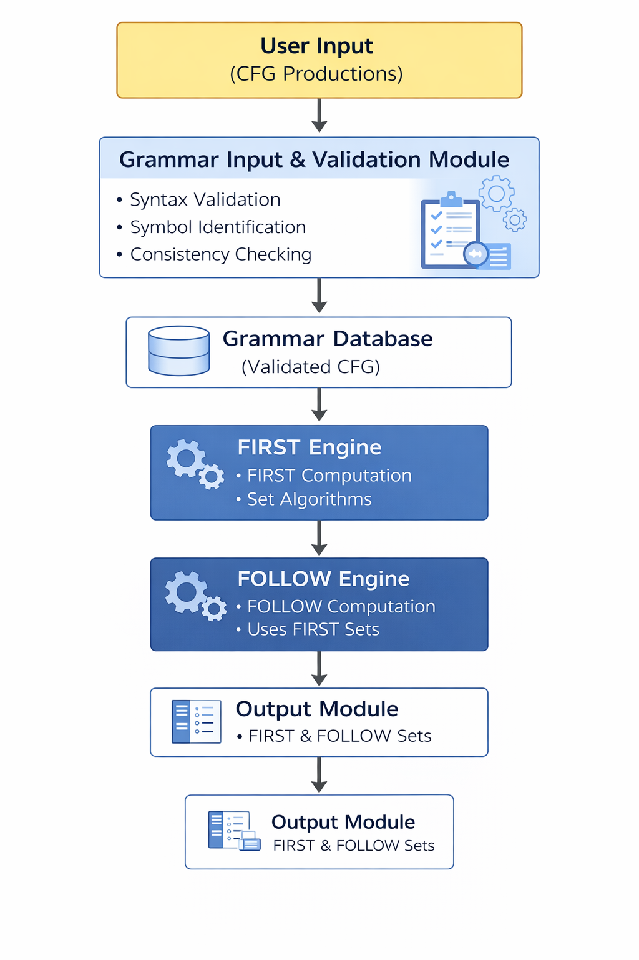
ARCHITECTURE DIAGRAM

Slide 10
EXISTING METHODS AND PROPOSED STRUCTURED METHODS
Module | Topic | Existing Method | Proposed Structured Method
Module 1: FIRST Engine | FIRST set computation | Manual FIRST set calculation using textbook rules | Automated FIRST set computation from CFG using standard set algorithms ensuring correctness and reliable parsing information
Module 2: FOLLOW Engine | FOLLOW set computation | Manual and error-prone FOLLOW set derivation | Automated FOLLOW set computation using FIRST sets and standard algorithms for accurate parsing information
Module 3: Grammar Input & Validation Module | Grammar input and validation | Manual grammar checking without validation support | Automated grammar input with syntax, symbol, and consistency validation to prevent invalid grammars

Slide 11
Visual Output

Slide 12
CONCLUSION
Ensures accurate and reliable parsing information for compiler design tasks.
Grammar input validation prevents invalid or inconsistent grammar entries.
Reduces manual effort and time required for syntax analysis.
Provides a structured and systematic approach for parser development and testing
Automated methods significantly reduce human errors in FIRST and FOLLOW set computation.

Slide 13
References
Aho, A. V., Lam, M. S., Sethi, R., & Ullman, J. D. (2007). Compilers: Principles, Techniques, and Tools (2nd ed.). Pearson.
Tremblay, J. P., & Sorenson, P. G. (2007). The Theory and Practice of Compiler Writing. McGraw-Hill.
Grune, D., van Reeuwijk, K., Bal, H. E., Jacobs, C. J. H., & Langendoen, K. (2012). Modern Compiler Design (2nd ed.). Springer.
Holub, A. I. (2009). Compiler Design in C (2nd ed.). Prentice Hall.
Louden, K. C. (2003). Compiler Construction: Principles and Practice (2nd ed.). Cengage Learning.
Ullman, J. D. (2001). Elements of Compiler Design. Prentice Hall.
Appel, A. W. (2004). Modern Compiler Implementation in Java (2nd ed.). Cambridge University Press.

Slide 14


